Slide 1
Azure Landing Zones
Modern Architecture for a Modern Datacenter

Slide 2
Attention
MMS sessions are 60-75 minutes followed by LONG Q&A
Please hold detailed questions until that Q&A starts
Feel free to ask clarification questions
Remind the speakers to use Zoom It when you can’t see

Slide 3




Scott Corio
Donnie Taylor
Microsoft MVP
Microsoft MVP
dumpsterdave
in/ScottCorio
donnietaylor
in/DonnieTaylor

Slide 4
Azure Landing Zones
What exactly are Azure Landing Zones?
Application vs Platform Landing Zones
Hub and Spoke vs Florida Network Topology
When do Landing Zones not make sense?
How to manage costs with Landing Zones?
How are Private Endpoint and Private Links Important in this model?
Can I still blame DNS for all my problems?
How to properly secure Landing Zones
How do I design workloads to fit into or migrate to the landing zone model?

Slide 5
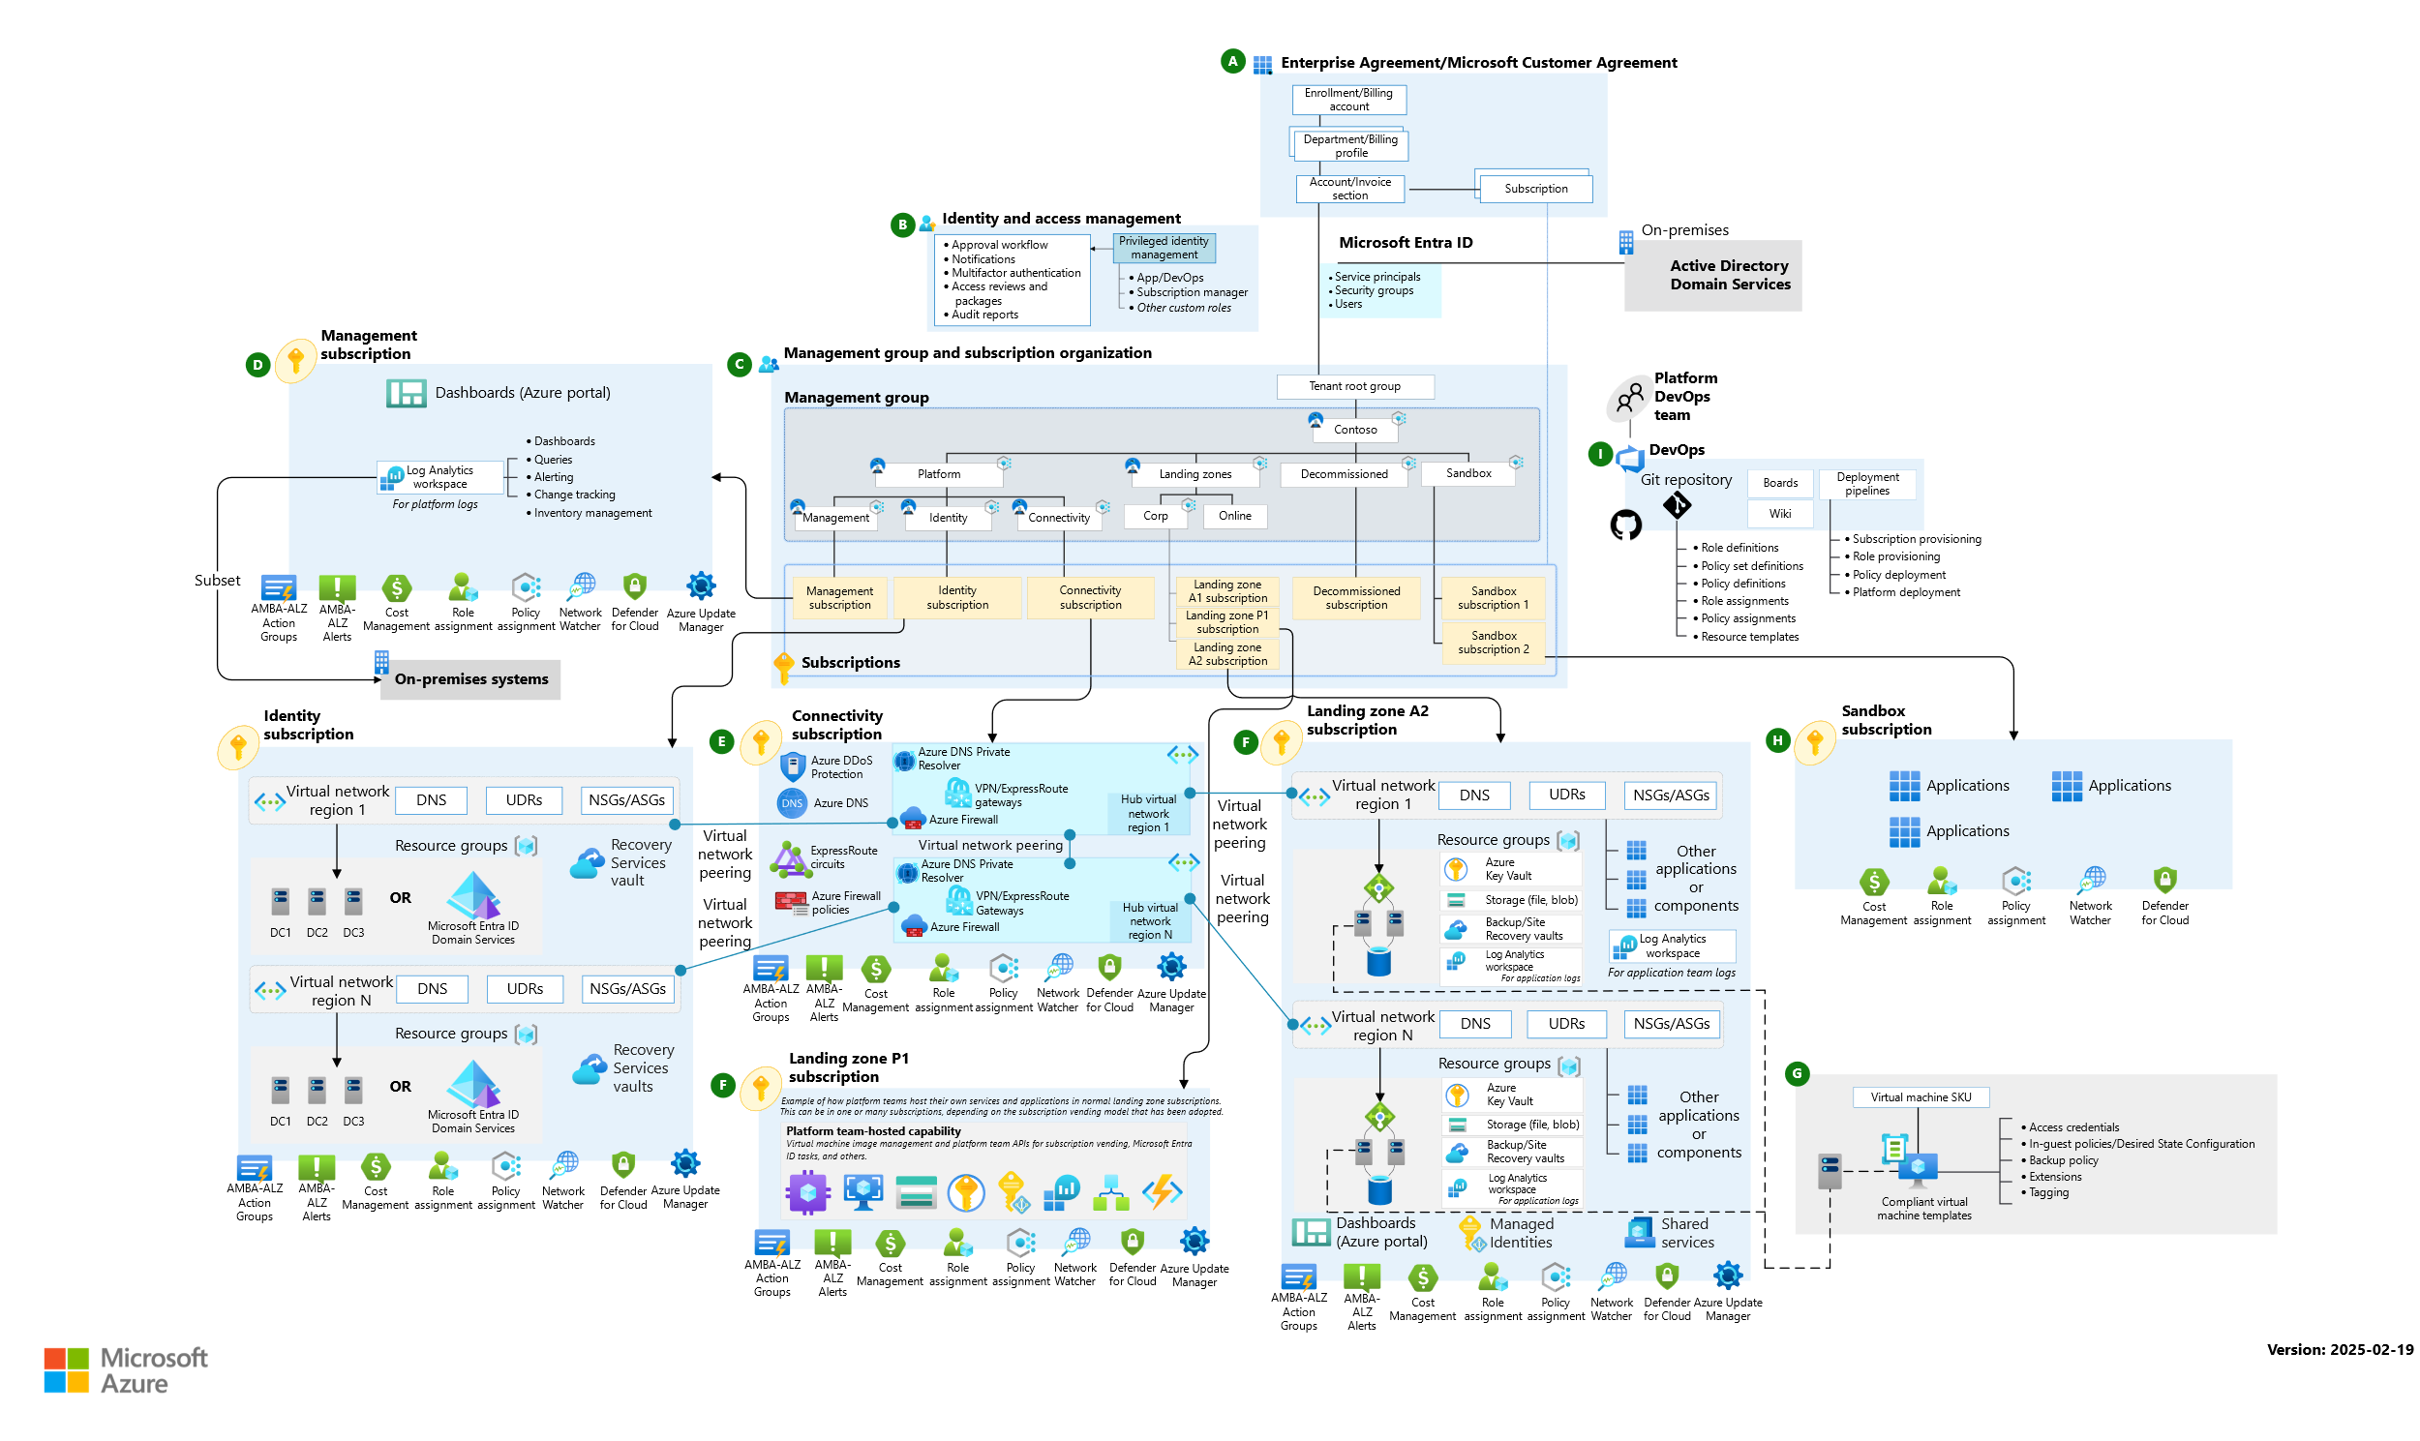
Cloud Adoption Framework

Slide 6
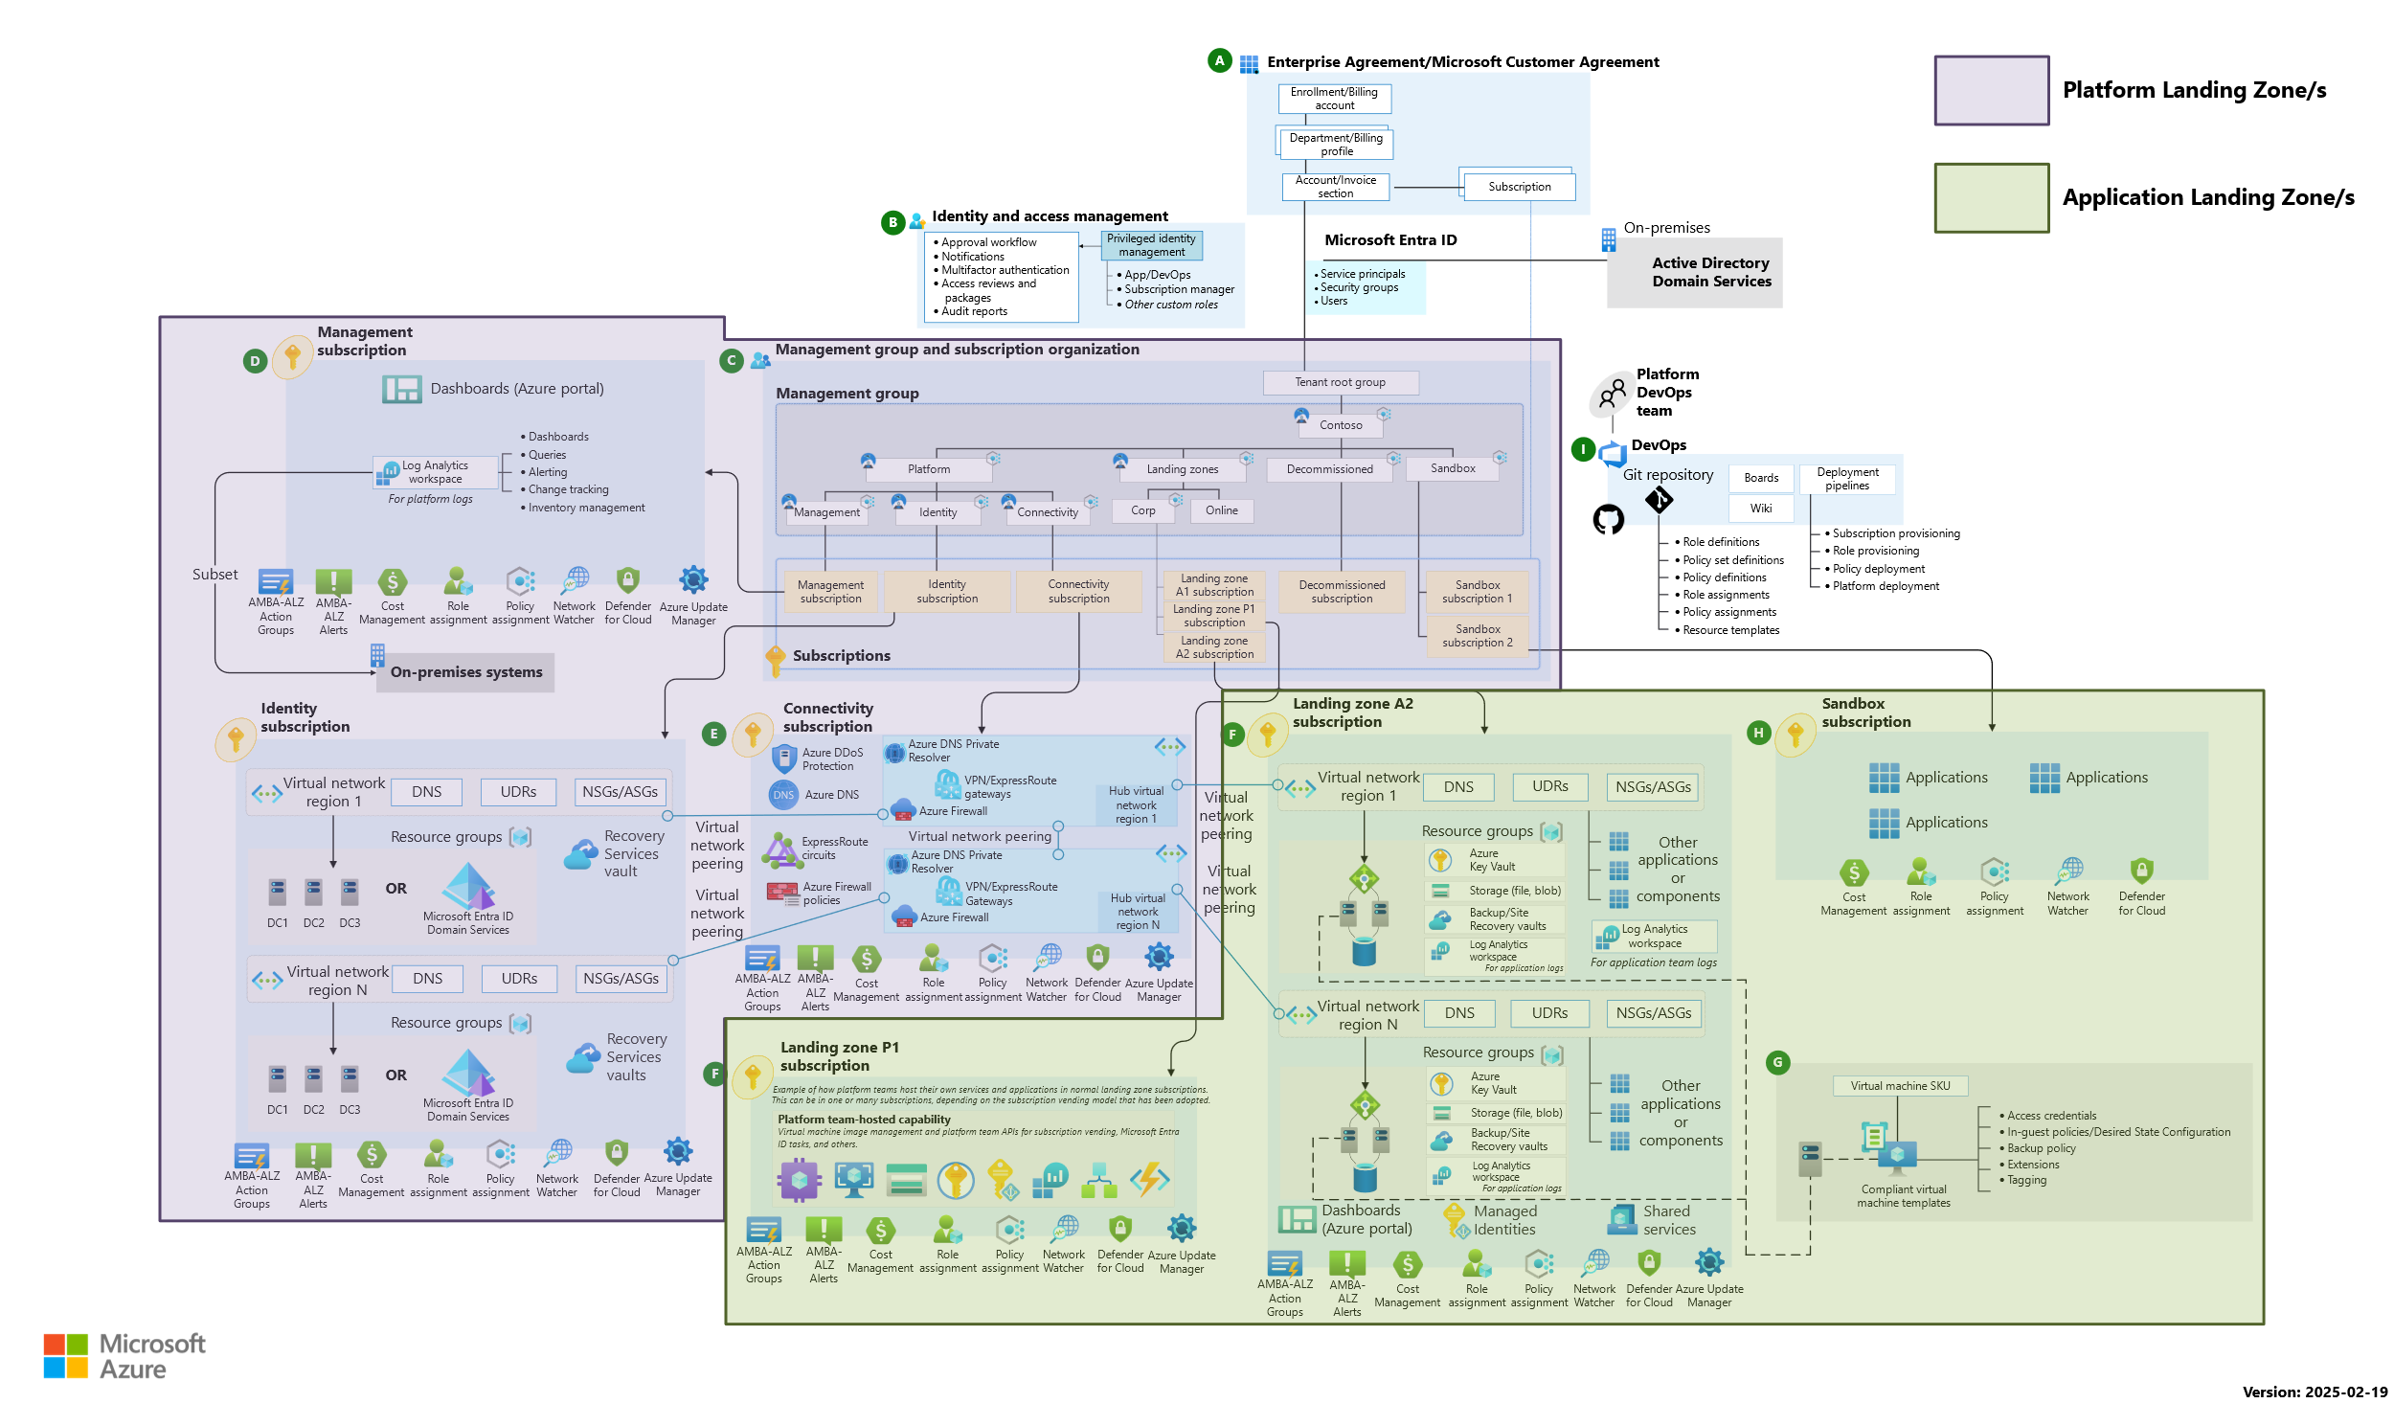
Cloud Adoption Framework - Demarked

Slide 7
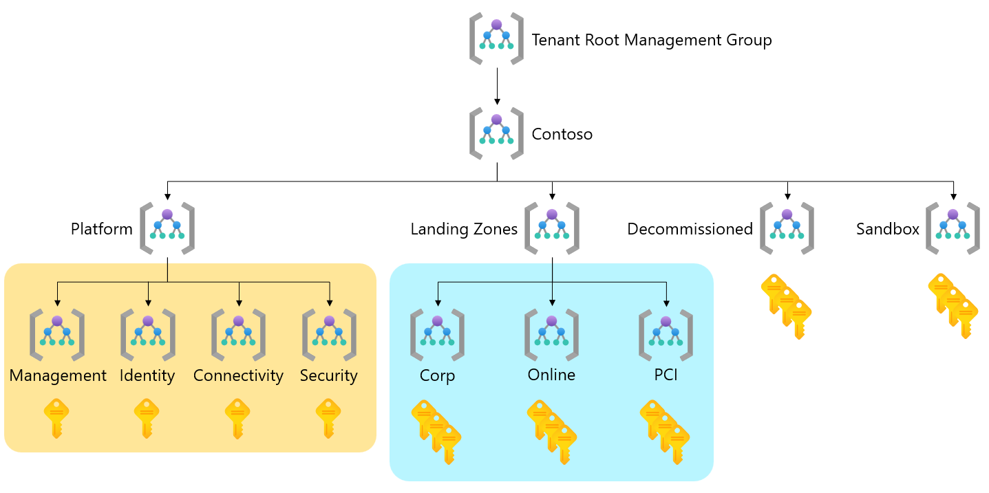
Management Group Primer

Slide 8
Subscription and Resource Structure

Slide 9
What is an Azure Landing Zone?
A Landing Zone is a location that workloads can “Land” in the cloud.
Broken up into Platform and Application Landing Zones
Applications can be a single line of business app such as SAP or a single priority workload
Applications could also be a collection of workloads maintained by a single group (ex: finance apps, marketing apps, sales apps, etc)
Each Landing Zone consists of one or more subscriptions that all resources reside in (Typically a Prod and Non-Prod)
A Landing zone is the top level that access or policy should be applied for a given application/collection.

Slide 10
What is an Azure Landing Zone? Contd.
A scalable, modular architecture to meet various deployment needs
Repeatable
Conceptual architecture (There is no set layout/one way to do it)

Slide 11
Platform Landing Zones
Platform Landing Zones are generally Shared Services that deliver a global/environment wide function
Firewalls/Network
Shared Services (Logs, Automation Accounts, etc)
Domain Controllers/Authentication Services
Ingress Technologies (Front Door/App Gateway/API Management Service)
Platform Landing Zones should be owned by core infrastructure teams and access should be tightly controlled
Platform Landing Zone networks may or may not be peered to each other

Slide 12
Application Landing Zones
Each application landing zone should host a single LoB Application or a singe departments applications
Application Landing Zone networks should not be peered, though exceptions could be present
Pick an IP range that can be re-used for all landing zones (a /20 or /19 is a good starting point)

Slide 13
Workload Design
Application Landing zones are not [really] designed for legacy (IaaS) focused workloads
IaaS resources can still play a supporting role in a landing zone
Resources that utilize Private Endpoints/Private Links are best suited for Landing Zones
Utilize Private Endpoints to access LZ resources from within your network
Containers instead of VMs, Azure SQL instead of Microsoft SQL
DevBox for local resource access. DevOps Managed Pools for secure container registry access.
Workloads should leverage Azure RBAC for secure access (not ACLs or AD Permissions)

Slide 14
When to Landing Zone
Landing Zone
No Landing Zone
Modern Workload
One or Two Services
External Accessibility
Regulatory Restrictions
Isolation Requirements
3rd Party Firewall Requirements
Local Connectivity Only
Chargeback/Shameback Billing

Slide 15
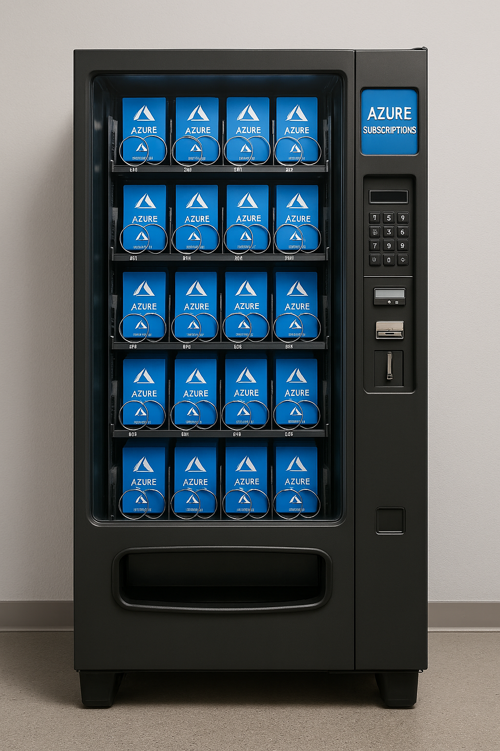
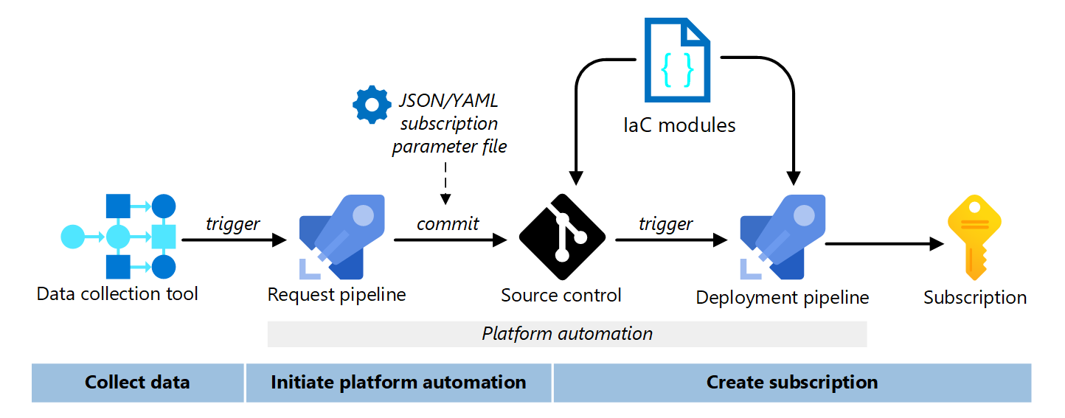
Landing Zone Vending
Give the power back to the people – self-service landing zones!

Slide 16
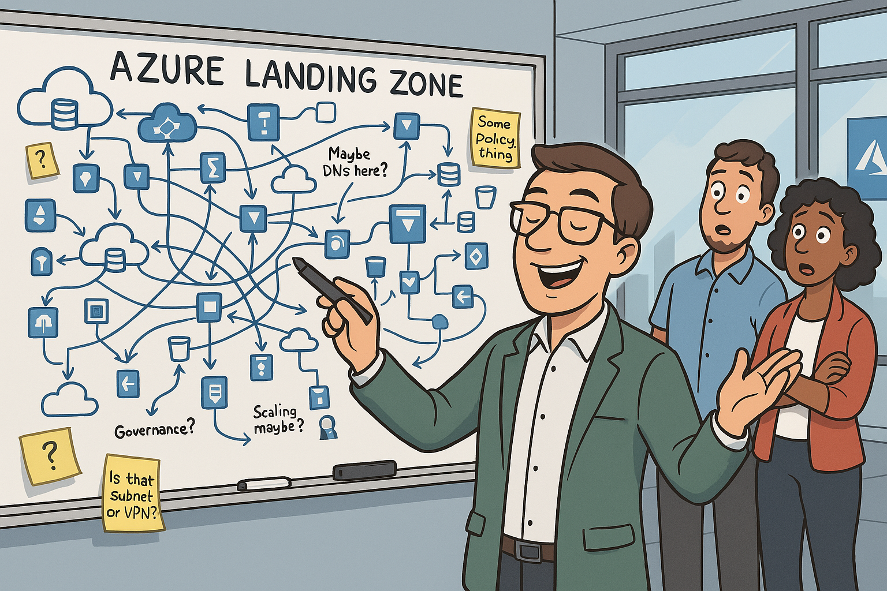
Data Collection and Pipelines
Data Collection
Pipelines
Forms
Power Apps
Logic Apps
Power Automate
Excel/CSV documents
Custom Web Apps
APIM
GitHub
Azure DevOps
Jira

Slide 17
LZ and Vending Considerations
Can be complex to setup – use the Accelerator!
Learning curve – that’s why you are here
You gotta control those costs – make sure you got those approval processes in place
App teams need to adapt to the LZ and vending process
It doesn’t matter what deployment language you use (as long as it’s Terraform) – Michael Scott

Slide 18
Vending

Slide 19
Network Considerations
Decide on isolation and subnet layout
Isolated Landing Zones can re-use the same IP block
Determine VNet IP Space size
/19 or /20 is a good starting point
Determine your ingress traffic control requirements
App Gateway/Azure Front Door/API Management/3rd Party Firewall
Determine Management/Local Access Infrastructure
Virtual Desktop/DevBox/Bastion
Determine outbound connectivity
NAT Gateway/Firewall/etc
Determine Inter-Zone connectivity
Private Endpoints

Slide 20
So About those Private Endpoints……………….
ALL Azure Networking is Software Defined Networking
There is no magical Cat6 cable that connects your services, servers, and platforms to each other
All Connectivity traverses the "public" Azure Network… Your VNets, Routes, and Peers determines where it can go on that network
A Private endpoint is just a fancy DNS trick that isolates your resources so that traffic can only originate from your "network".
There is no way to 100% isolate Azure traffic to your network in a physical capacity (remember, there is no "Cat6 Cable").
Private Endpoints can be used to "link" resources to networks without linking networks.

Slide 21
Private Endpoint Cost Considerations
$0.01 / hour per private endpoint
Data Charges
$0.01/GB for the first PB
$0.006/GB for 1-5 PB
$0.004/GB for 5+ PB
Inbound and Outbound Data cost the same, but are separate thresholds
Writing to a storage account counts as outbound data (Data is going OUT OF the private endpoint to the resource)
Reading from a storage account counts as inbound data (Data is going from the resource INTO the private endpoint)
Resources cannot initiate traffic over their own private endpoint
An App Service with a private endpoint cannot use it to connect to a database or storage account, however it can use the database or storage accounts private endpoint. VNet Integration is required to fully isolate traffic.

Slide 22
Private Endpoint Cost Examples
Example A: Storage account that used as an archive to store 100GB of logs /month
$0.01/hr * 730 hours = $7.30
100GB of outbound data = $0.01/GB * 100GB = $1.00
$8.30/mo
Example B: Storage account used as a (massive) application cache
$0.01/hr * 730 hours = $7.30
0.5 PB of outbound data = $0.01/GB * 500,000GB = $5,000.00
2 PB of inbound data = $0.01/GB * 1,000,000GB + $0.006/GB * 1,000,000GB = $16,000
$21,007.30/mo

Slide 23
How does a Public Endpoint Work?
Client
Local DNS
Public DNS
Client Searches for DB1.database.windows.net
Not Authoritive for database.windows.net
Authoritive for database.windows.net
104.21.45.159
Record Found

Slide 24
How does a Private Endpoint Work?
Client
Local DNS
Public DNS
Client Searches for DB1.database.windows.net
Not Authoritive for database.windows.net
Authoritive for database.windows.net
Client Searches for DB1.privatelink.database.windows.net
Record Found, PE Found, Return CNAME
ALIAS: DB1.privatelink.database.windows.net
Authoritive for privatelink.database.windows.net
10.1.10.126

Slide 25

What About Egress Traffic?
Public Network
Azure Resource
Local Network (Azure or On-Prem)
Resource
Resource
Resource
Egress traffic always flow over the public internet, even with a private endpoint

Slide 26
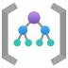

Management Group Structure
Tenant Root
Organization Root
Platform MG
APP LZ MG
Exceptions
APP 1
APP 2
APP 3
Production
Production
Production
Non-Production
Non-Production
Non-Production

Slide 27
Building a Landing Zone

Slide 31
References
CAD – Landing Zones

